Slide 1
Angular – Week 6
Directives
Pipes

Slide 2
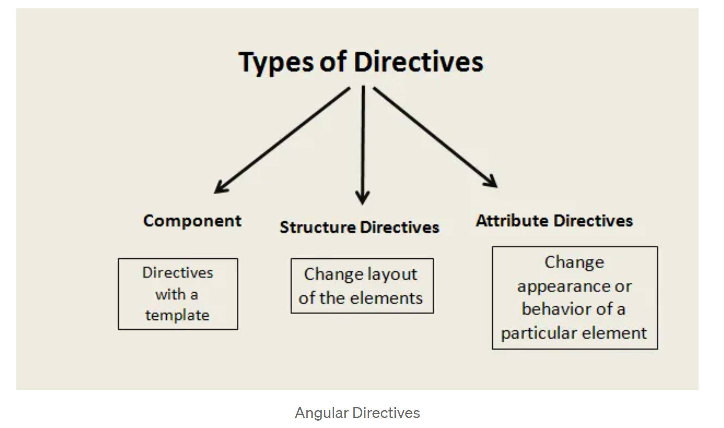
Directives
Directives are custom HTML attributes which tell angular to change the style or behavior of the Dom elements.

Slide 3
Component Directives
Components are directives with templates. The only difference between Components and the other two types of directives is the Template. Attribute and Structural Directives don't have Templates. So, we can say that the Component is a cleaner version of the Directive with a template, which is easier to use.

Slide 4
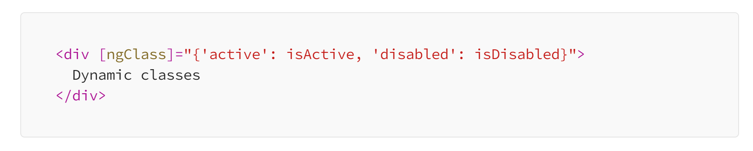
Attribute Directives
Attribute directives listen to and modify the behavior of other HTML elements, attributes, properties, and components.
We use attribute directives to apply conditional style to elements, show or hide elements or dynamically change the behavior of a component according to a changing property.
Examples
ngClass : The ngClass directive allows you to dynamically apply CSS classes to an element based on conditions or expressions.

Slide 5
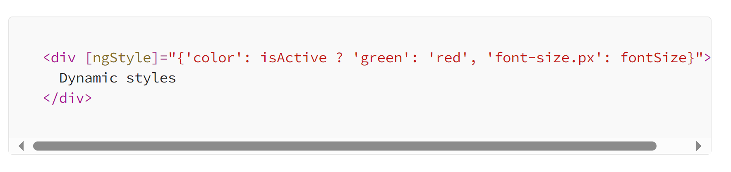
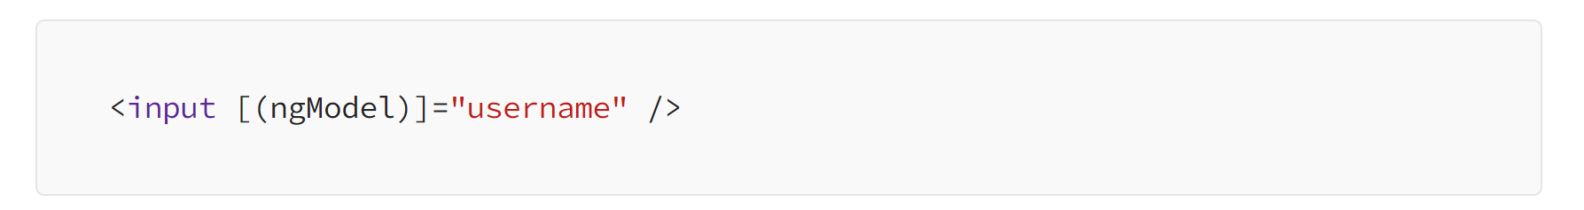
Attribute Directives
ngStyle : The ngStyle directive lets you apply inline styles to an element based on conditions or expressions.
ngModel : The ngModel directive is used for two-way data binding with form elements like input, select, and textarea.

Slide 6
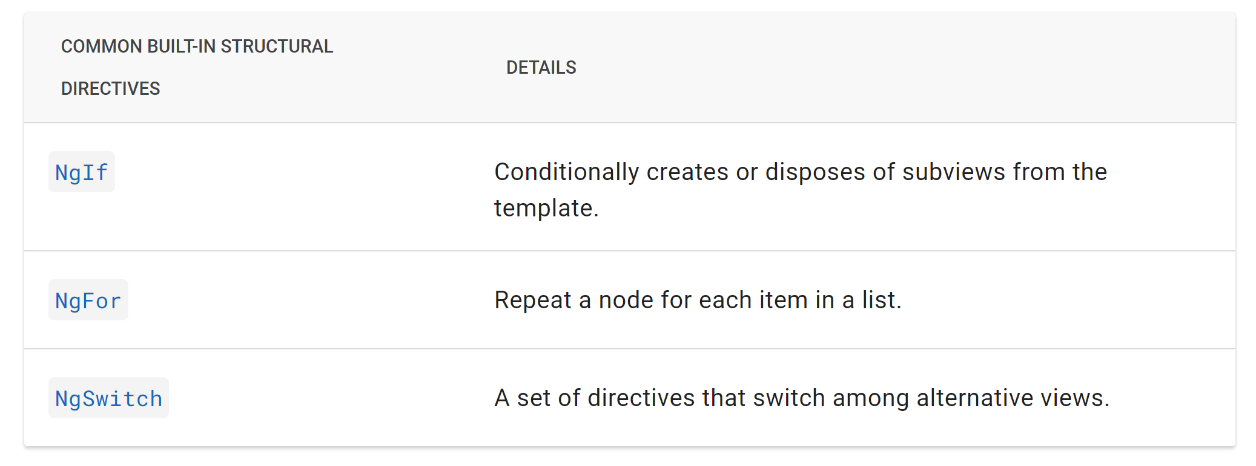
Structural Directives
Structural directives are responsible for HTML layout. They shape or reshape the DOM's structure, typically by adding, removing, and manipulating the host elements to which they are attached.

Slide 7
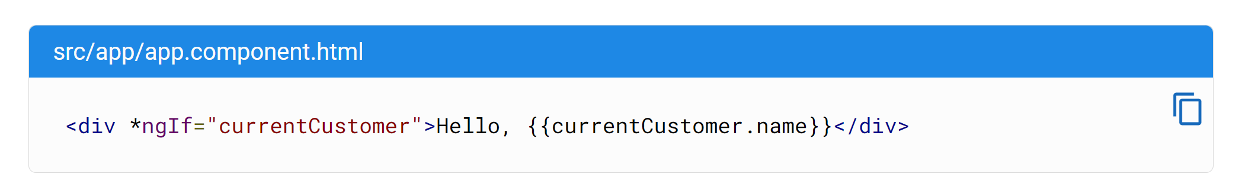
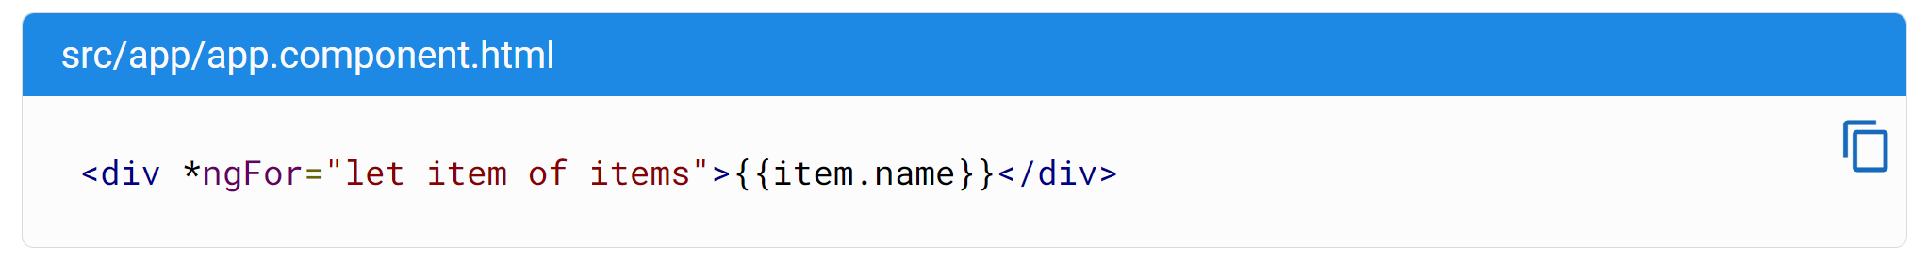
Structural Directives
Adding or removing an element with NgIf
By default, NgIf prevents display of an element bound to a null value.
To use NgIf to guard a <div>, add *ngIf="yourProperty" to the <div>. In the following example, the currentCustomer name appears because there is a currentCustomer.
Listing items with NgFor
Use the NgFor directive to present a list of items.
Define a block of HTML that determines how Angular renders a single item.
To list your items, assign the shorthand let item of items to *ngFor.

Slide 8
Conditional Rendering (Angular 17+)
@if() {}
@for( track ){} https://angular.dev/tutorials/learn-angular/5-control-flow-for

Slide 9
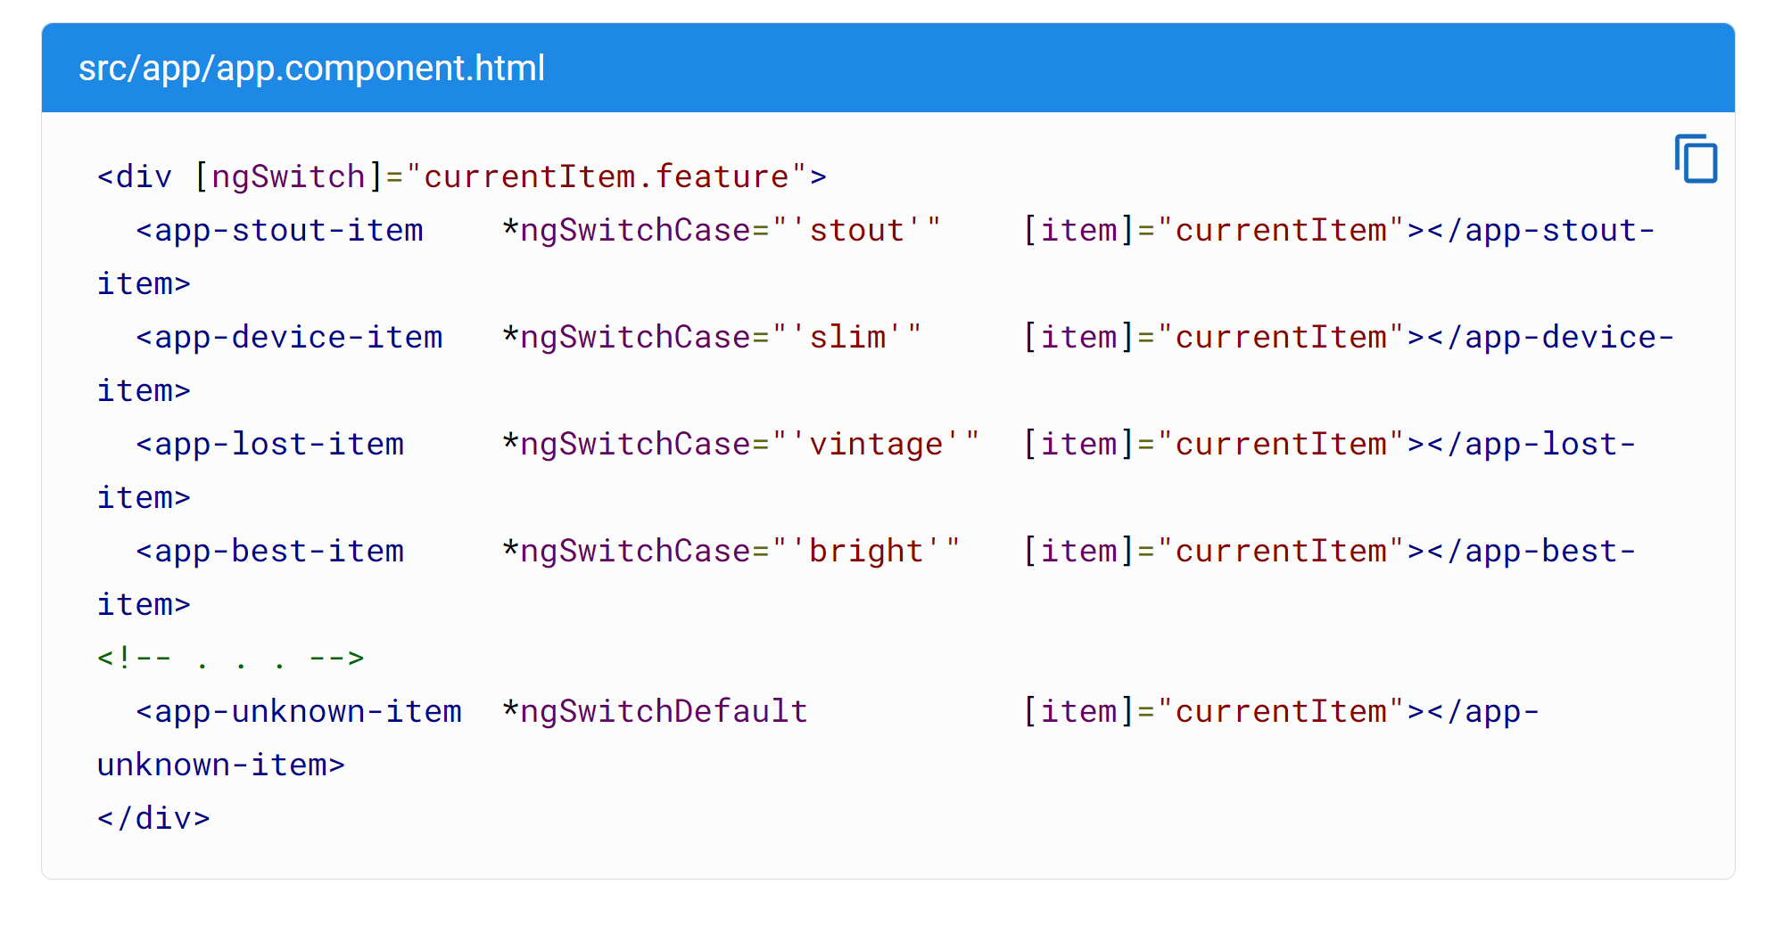
Structural Directives
Switching cases with NgSwitch
Like the JavaScript switch statement, NgSwitch displays one element from among several possible elements, based on a switch condition. Angular puts only the selected element into the DOM.

Slide 10
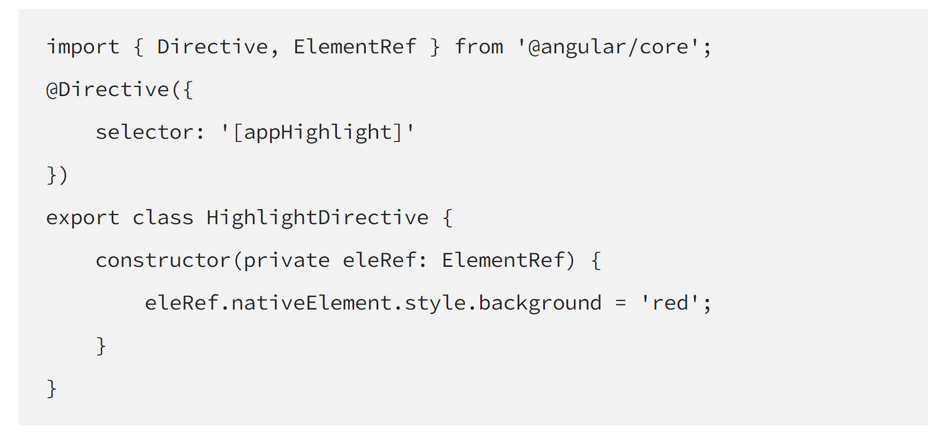
Creating a Custom Attribute Directive
Creating a custom directive is just like creating an Angular component. To create a custom directive we have to replace @Component decorator with @Directive decorator.
Create an app-highlight.directive.ts file in src/app folder and add the code snippet below.

Slide 11
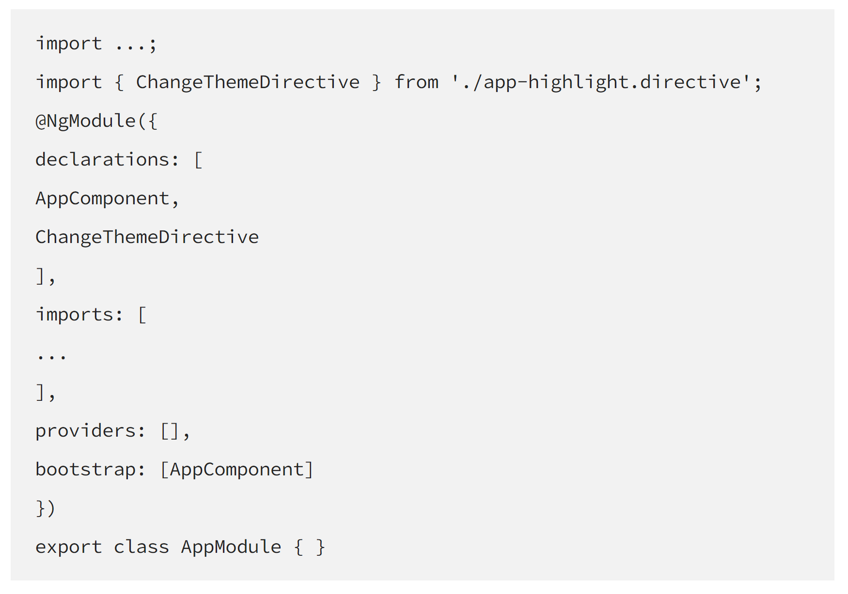
Creating a Custom Attribute Directive
Now to get appHighlight Directive to work, we need to add our Directive to the declarations array in the app.module.ts file.

Slide 12
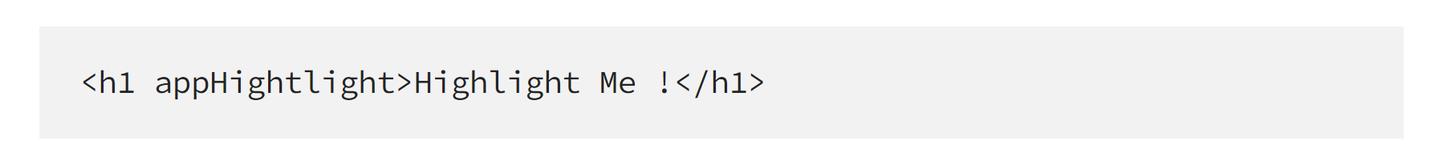
Creating a Custom Attribute Directive
Now we are going to use our newly created custom directive. I am adding the appHightlight directive in the app.component.html but you can use it anywhere in the application.

Slide 13
Pipes
Pipes in Angular are used to transform data without directly impacting the properties holding the data.
We can transform strings, currency amounts, dates, and other data for display. Pipes are simple functions to use in template expressions to accept an input value and return a transformed value.
We can use built-in pipes and can also create custom pipes as well.
Pipes transforms the way data is displayed
| (symbol)

Slide 14
Built-in pipes
Angular provides built-in pipes for typical data transformations, including transformations for internationalization (i18n), which use locale information to format data. The following are commonly used built-in pipes for data formatting:
DatePipe: Formats a date value according to locale rules.
UpperCasePipe: Transforms text to all upper case.
LowerCasePipe: Transforms text to all lower case.
CurrencyPipe: Transforms a number to a currency string, formatted according to locale rules.
DecimalPipe: Transforms a number into a string with a decimal point, formatted according to locale rules.
PercentPipe: Transforms a number to a percentage string, formatted according to locale rules.
TranslatePipe
Var x = 2 | 3
{{ x | date }} || https://angular.dev/guide/templates/pipes

Slide 15
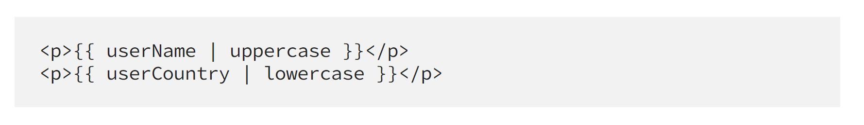
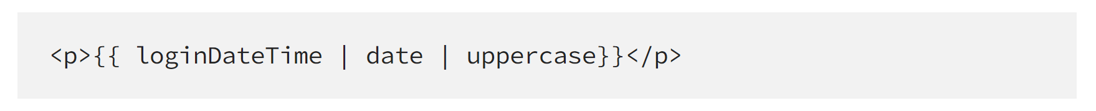
Pipes
Let’s understand them with an example:
All we have to do is write the pipe symbol | followed by name of the pipe being used like uppercase or lowercase.
Chaining multiple pipes
To chain multiple pipes together, we just have to use a pipe operator (|) between different pipe names, see the below code for example.
It will output formatted date followed by everything in uppercase like: SATURDAY, MAY 28, 2022

Slide 16
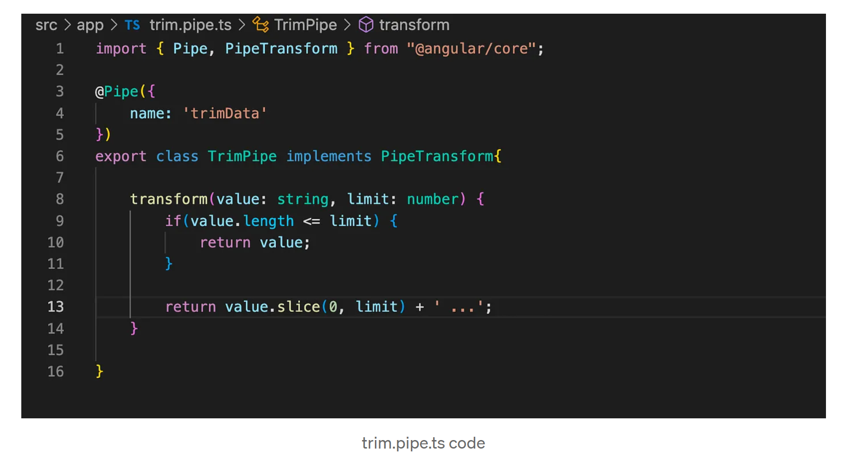
Creating Custom Pipes
We can also create our own pipes with a custom transform logic to it. Use command ng g p <name_of_pipe>, let say we create custom pipe which will trim the data up to a certain limit and then add … at the end if the value goes beyond that limit.
Start with running ng g p trim in your terminal:
This will create a trim.pipe.ts and also declare it in the app.module.ts declarations array. It will take the value and considering the limit argument and value length it will decide whether to return the value directly or return the sliced value followed by … characters
"3.2222222" 3 3.22

Slide 17
Thank you

